Slide 1
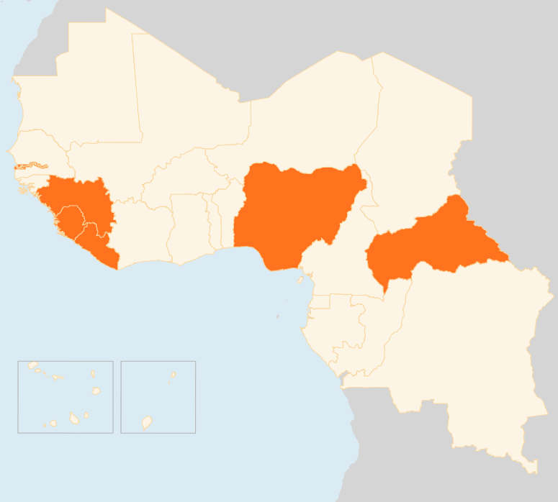

24 – 30 Mar 2015
CENTRAL AFRICAN REPUBLIC (CAR)
1.5 MILLION FACE FOOD INSECURITY
Farmers in CAR are in urgent need of seeds and tools for the upcoming planting season in April to prevent further deterioration of the livelihood of vulnerable populations, FAO said this week. Some 1.5 million people are currently food insecure and more could be affected if immediate support is not provided. Widespread looting and insecurity have taken a heavy toll on crops, livestock and fishing, and are eroding the capacity of people to secure enough food.
GUINEA
45-DAY EVD EMERGENCY MEASURES LAUNCHED
On 28 March, President Alpha Condé declared a 45-day “health emergency” in the prefectures of Forécariah, Coyah, Dubréka, Boffa and Kindia that include measures such as temporary closure of hospitals and clinics where cases are detected, stricter rules on burials and lockdowns to cut down infections. In the week that ended on 22 March, Guinea reported 45 cases. Ninety-five cases were recorded in the previous week - the country’s highest in 2015.
LIBERIA
FIRST EVD PATIENT IN THREE WEEKS DIES
On 27 March, a woman who became Liberia’s first Ebola patient in three weeks died. Around 200 people are being monitored for possible infection. So far none of the high risk contacts has shown EVD symptoms. Liberia has greatly reversed the spread of Ebola, which peaked in September 2014 with around 300 cases each week.
NIGERIA
ELECTIONS HELD
Nigerians voted on 28-29 March in presidential and legislative elections. The polling was largely calm. Results are expected this week. The run-up to the elections was marred by violence and there are concerns that the results could spark more unrest.
41 KILLED IN MILITIA ATTACKS
At least 41 people were killed on 28 March in separate attacks attributed to Boko Haram. The insurgents, who have been forced from several towns in recent weeks by Nigerian military and forces from neighbouring countries, had vowed to disrupt the polls. Violence by Boko Haram has displaced around 1.2 million people within Nigeria.
REGIONAL / EBOLA VIRUS DISEASE
79 CASES REPORTED, LOWEST IN 2015
With 79 confirmed cases reported, the seven days to 22 March saw the lowest infections rates in 2015. The figure also marked almost a 50 percent drop in cases compared to the previous week. A total of 24,872 suspected, probable and confirmed cases, and 10,311 deaths have occurred so far.
SIERRA LEONE
3-DAY LOCKDOWN OBSERVED
On 29 March, Sierra Leone concluded a three-day lockdown of the country’s capital Freetown and hotspot areas in the north and west in a bid to curb the spread of Ebola. Volunteers conducted door-door visits to check for sick people and raise awareness. Authorities reported overall compliance with the shutdown that confined around 2.5 million people in their homes.
SIERRA LEONE
3
DAY EVD SHUTDOWN
GUINEA
45
DAY EVD EMERGENCY PLAN LAUNCHED
NIGERIA
41
KILLED IN MILITIA ATTACKS
ELECTIONS HELD
CAR
1.5
MILLION FOOD INSECURE
LIBERIA
REGIONAL / EVD
1ST
EVD PATIENT IN THREE WEEKS DIES
79
CASES, LOWEST IN 2015
Creation date: 31 March 2014
Map data sources: UNCS, DevInfo, OCHA.
The boundaries and names shown and the designations used on this map do not imply official endorsement or acceptance by the United Nations

